Slide 1


PRACTICAL CLASSROOM ACTIVITIES
FOR TEACHING NEWS LITERACY

Slide 2

Judging Sources Activity:
Advise Your Friend
You and your friend are debating why gas was so expensive during the summer of 2022. You Google it to settle the debate but get more answers than you know what to do with: war, supply and demand, climate change ...
Your friend chooses an article with the headline “Yes, you can blame Biden for crazy gas prices—here’s why,” from a source she thought she’d heard of before, but is not sure if it's reliable.
In this activity your job is to tell her what potential pitfalls she should pay attention to based on the publication the article came from: the New York Post.

Slide 3
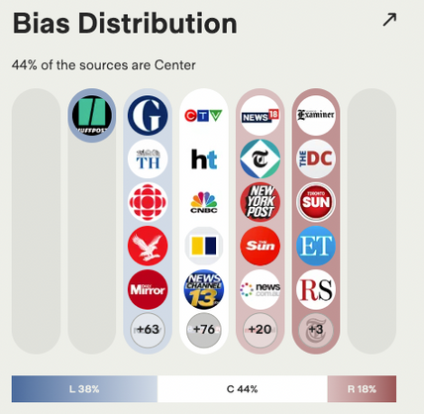
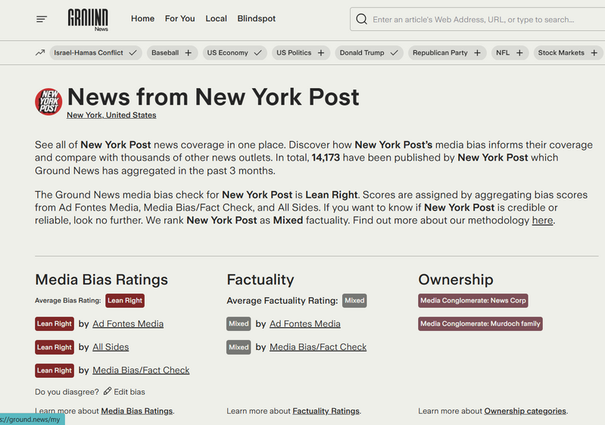
Tool 1: Media Bias Rating
1. Use Ground News to look up “nypost.com” as a source. What is the New York Post’s Bias Rating?
2. How does a publication that “leans right” differ from a publication that is “far right” or “far left” according to the Ground News methodology?
3. Use Ground News to select a story that interests you. Filter your search results by Factuality, starting with High, then moving to Mixed and Low. Do the scores for any particular media group surprise you?

Slide 4
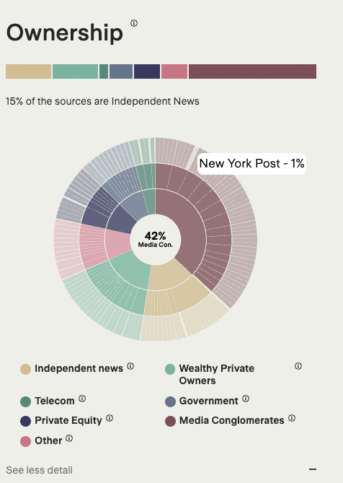
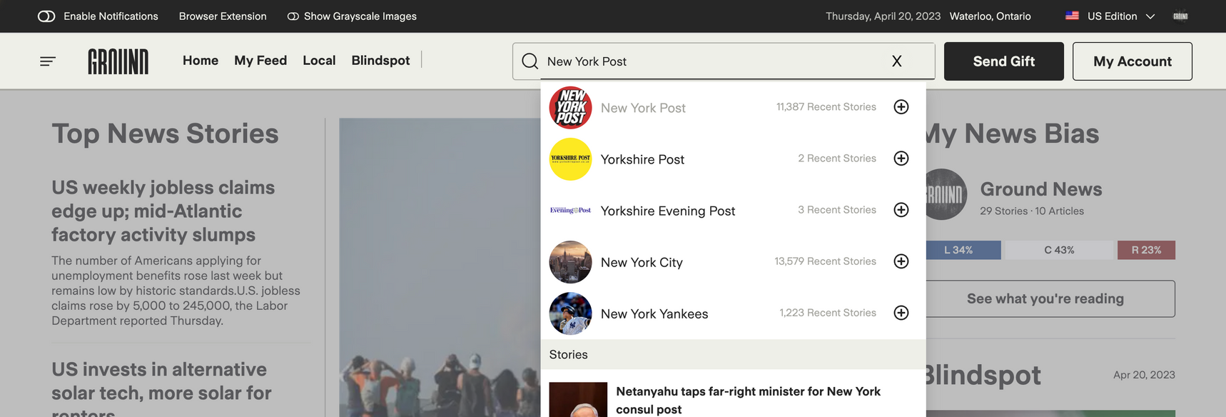
Tool 2: Ownership
1. Who owns the New York Post?
2. What do the colors behind the ownership categories of the New York Post signify?
3. Read this article about the significance of media ownership and jot down your findings.
4. Based on the ownership information, would you edit your previous recommendation?

Slide 5
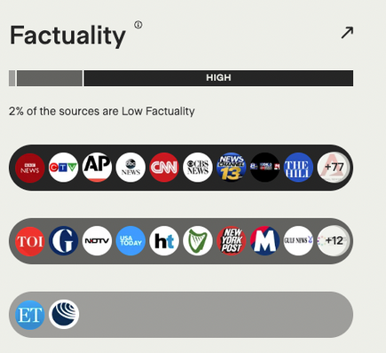
Tool 3: Factuality
1. What is the New York Post’s Factuality score?
2. What factors go into the Ground News Factuality Score?
3. Use Ground News to select a story that interests you. Filter your search results by Factuality, starting with High, then moving to Mixed and Low. Do the scores for any particular media group surprise you?

Slide 6
Activity
Based on the Bias, Ownership, and Factuality ratings of the New York Post, would you recommend that your friend include this institution in her regular news diet? Why or why not? Explain your recommendation using several pieces of supporting logic from the activity above.

